Slide 1
Thread Scheduler Efficiency Improvements for Multicore Systems
Daniel Collin Frazier
Division of Science and Mathematics
University of Minnesota, Morris
Morris, Minnesota, USA
18 November 2017
UMM, Minnesota
DRAFT
Todos in Yellow

Slide 2
Introduction
The thread scheduler is an important system component that is always running
It manages the runtime that programs receive
Because it is a system component, it must be as efficient as possible
Reduce time spent doing critical managerial tasks (time spent in the “critical section”)
The problem of thread scheduling has been around since the 1960s and for a while, scheduling implementation was largely unchanged
Increasing hardware requirements in the early 2000s made the problem more complex

Slide 3
“And you have to realize that there are not very many things that have aged as well as the scheduler. Which is just another proof that scheduling is easy.”
Linus Torvalds, 2001 [2]
Mhmmm… sure… :)

Slide 4
Overview
Establish needed concepts
Thread scheduling and thread load-balancing on Linux
Bug fixes and two new developments to the Linux thread scheduler

Slide 5
Before we talk about thread scheduling,
let’s get some terms out of the way!

Slide 6
Outline
Establish needed concepts
Threads, Multithreading Programs
Parallel programming
Synchronicity and Locks
Thread scheduling and thread load-balancing on Linux
Bug fixes and two new developments to the Linux thread scheduler

Slide 7
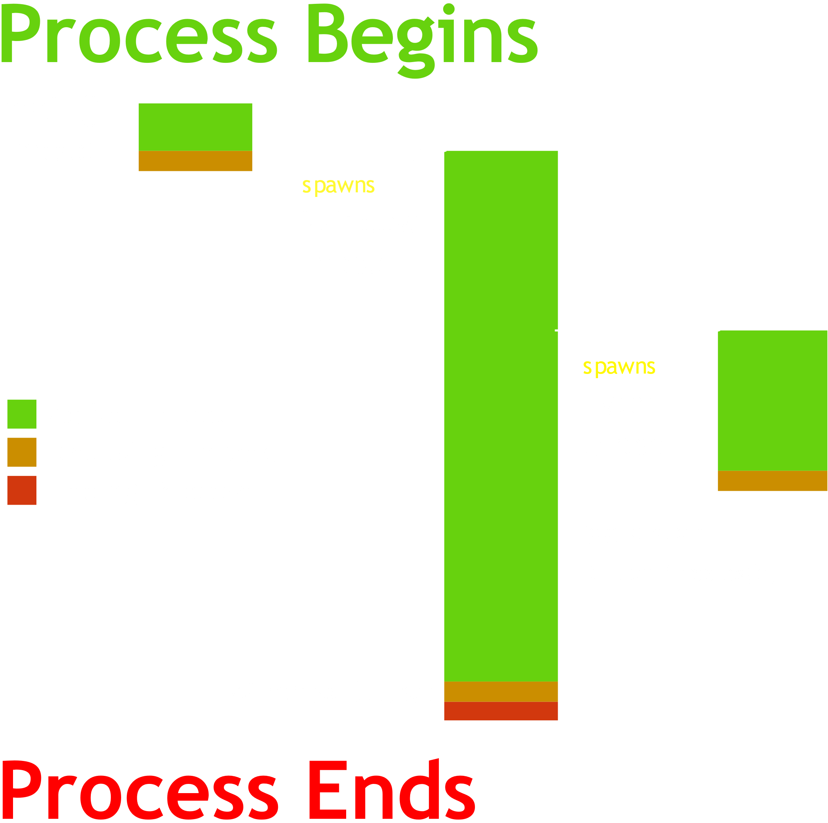
Using Threads
Threads allow a program to run more than one independent task at one time
Useful for…
Programs with long, mostly-independent computations
Programs with graphical interface
Example GUI Program (right)
In this figure three Threads are created within one Process.

Slide 8
Using Threads
A multithreaded program is a program that employs threads
Concurrent computing techniques are techniques that allow many tasks to occur at the same time [W]
Parallel computing techniques are techniques that allow many calculations to occur at the same time [W]
Problems can be solved or improved using neither, either or both of these techniques at once

Slide 9
Parallel Programming
[may not need this slide] probably best not, considering length

Slide 10
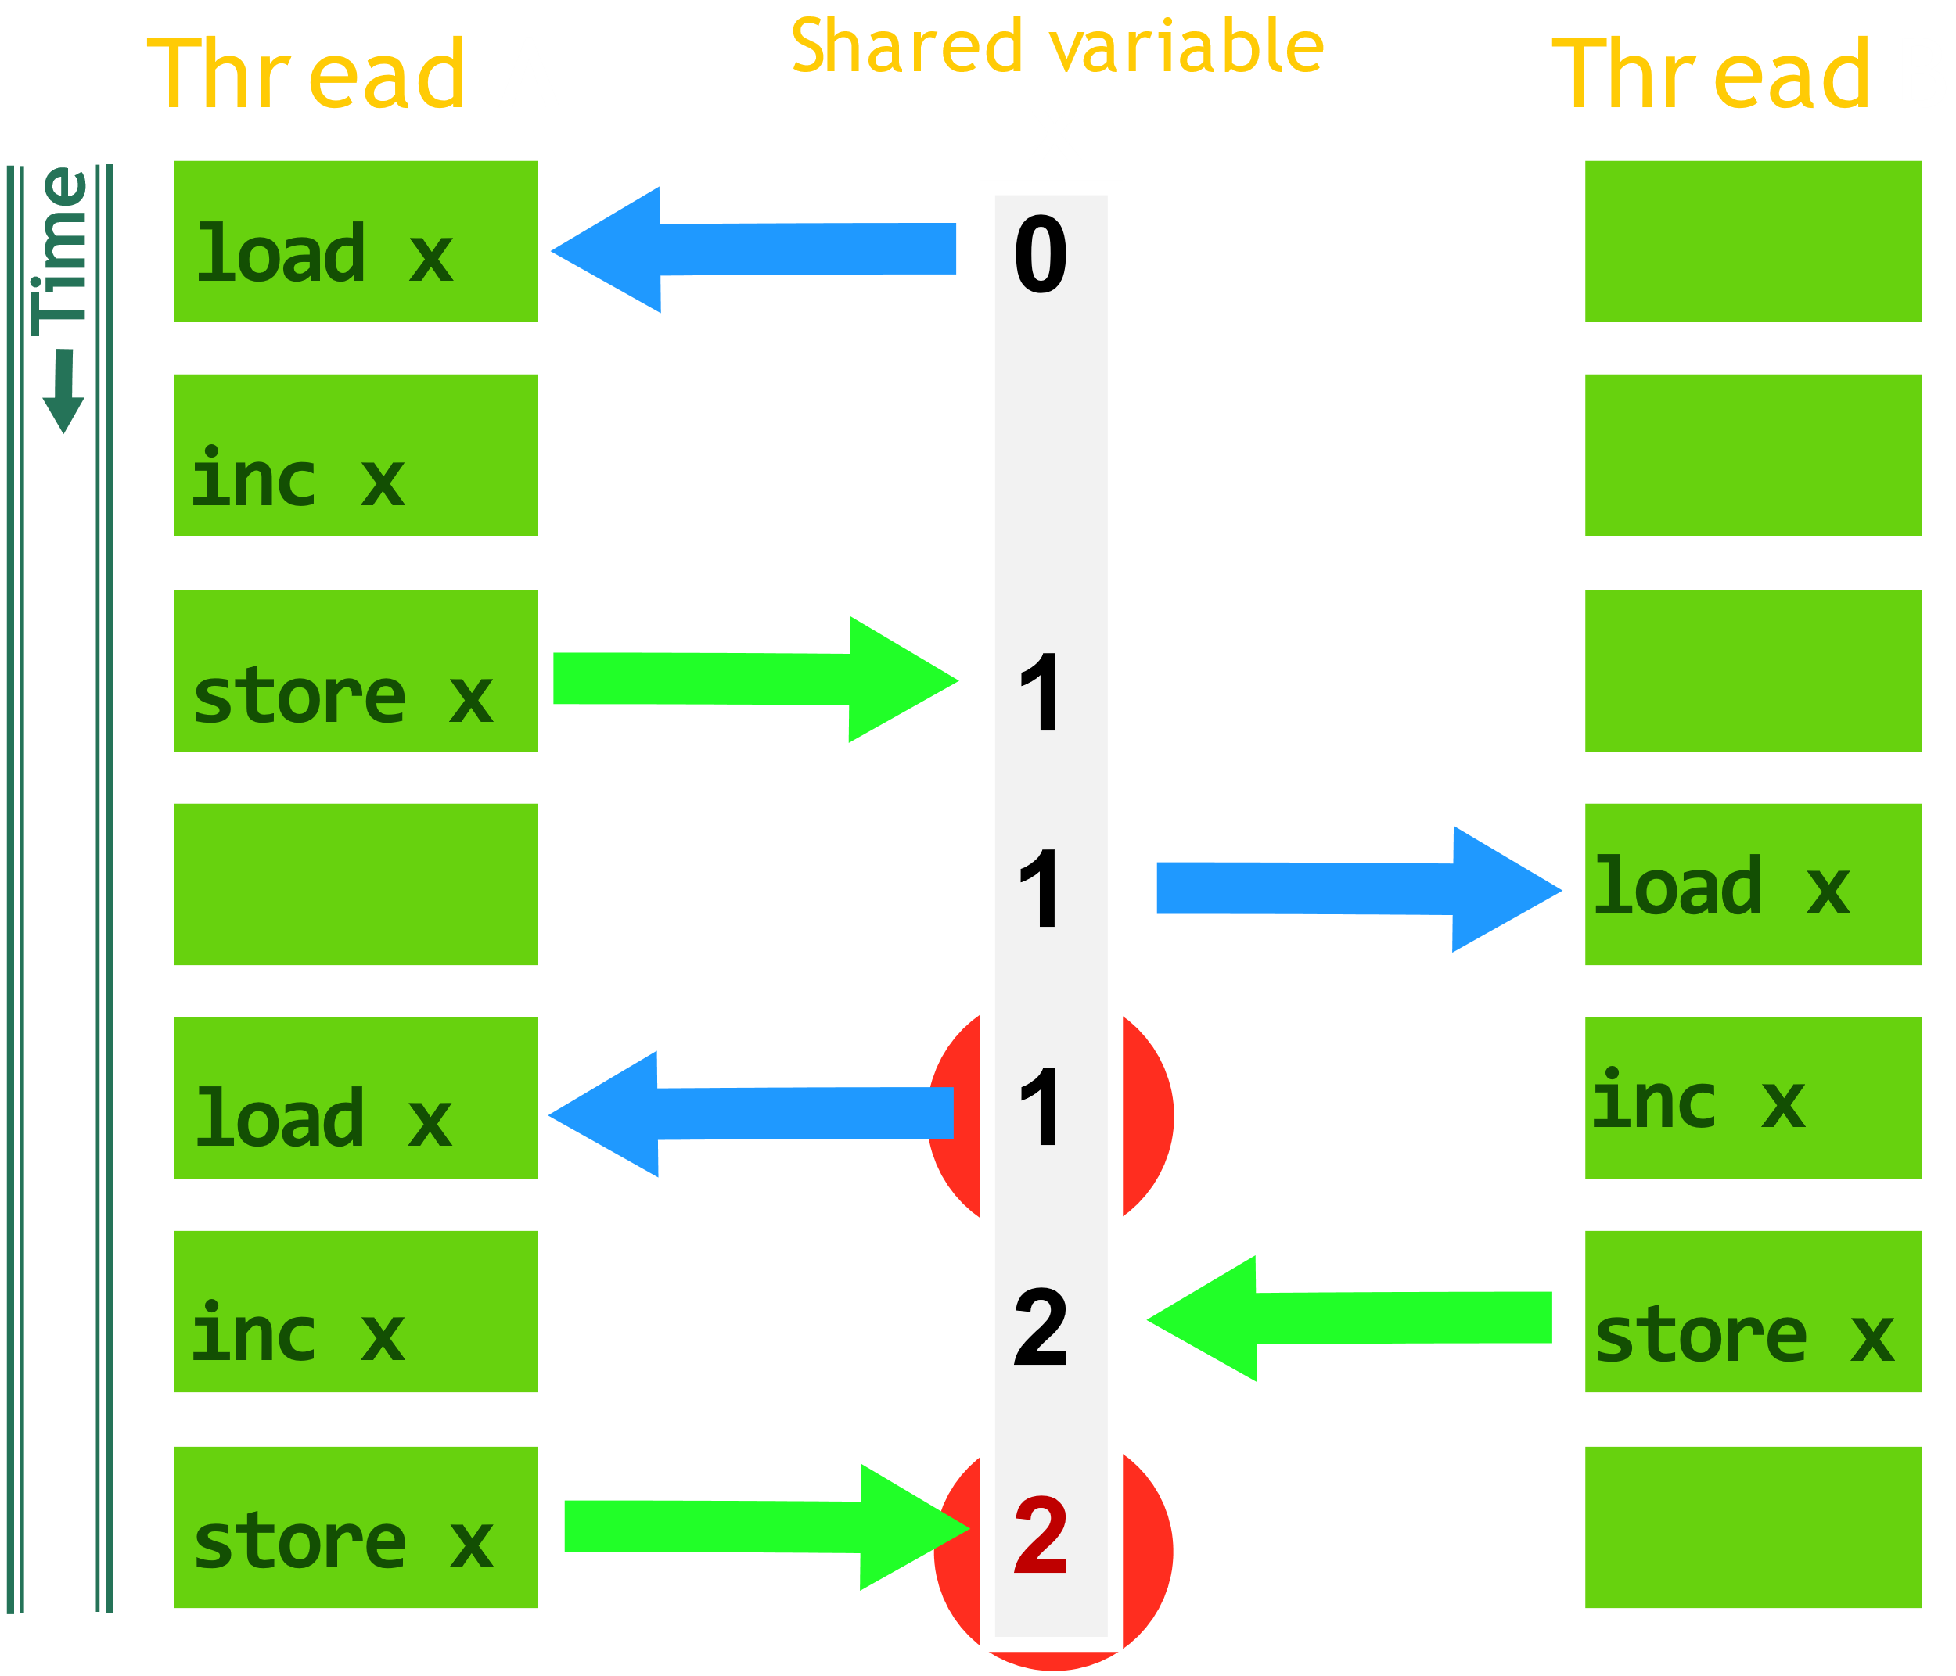
Race Condition (example)

Slide 11
Synchronicity and Locks
Synchronicity can achieved by employing locks
When locks are used properly, they fix race conditions
Locks secure objects or data shared between threads such that only one thread can read and write to it at one time
When a thread locks a lock, that thread “acquires” the lock
When a thread unlocks a lock, that thread “releases” the lock
Let’s fix the race condition in the previous example using locks

Slide 12
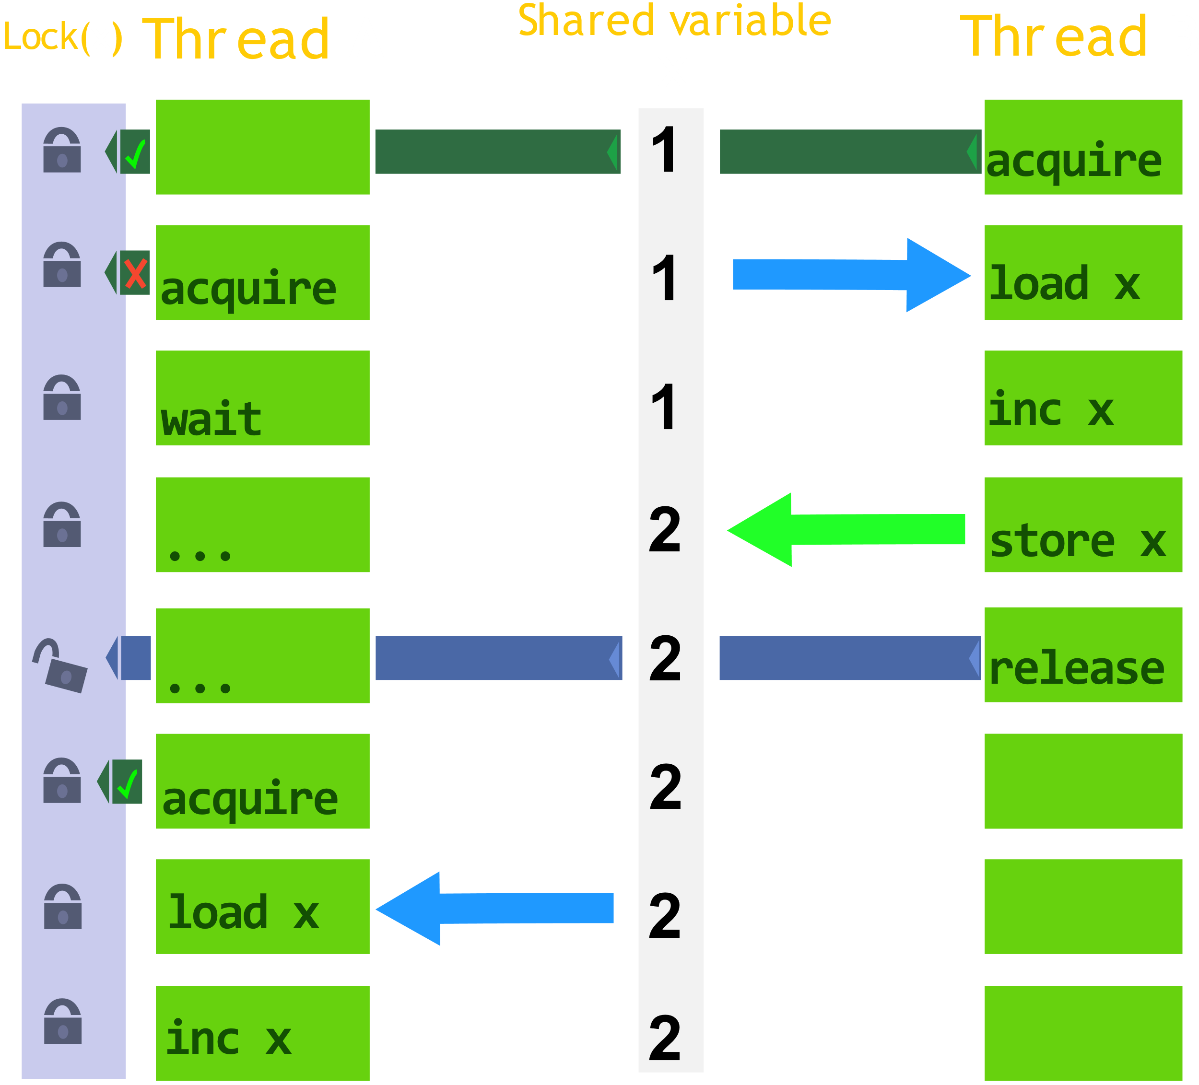
Lock Example

Slide 13
Outline
Establish needed concepts
Thread scheduling and load-balancing on Linux
Completely Fair Scheduler (CFS)
Cache and Scheduling Domains
Load Balance algorithm for the CFS
Bug fixes and two new developments to the Linux thread scheduler

Slide 14
Completely Fair Scheduler (CFS)
Default Linux Thread Scheduler (there are others)
Handles which threads are executed at what times and on which CPU cores
Spend a fair amount of runtime on all threads
The scheduler switches active threads by saving and restoring thread and processor state information.
Switching active threads and processes are called context switches.
The CFS implementation for single-core systems is simple
So for now, let’s assume single-core
We will cover what thread and process state information consist of after covering the CFS.

Slide 15
Completely Fair Scheduler (CFS)
Implementation of the weighted fair queueing (WFQ) scheduling algorithm
Goal:
Make sure all threads run at least once within an arbitrary interval of CPU cycles
Timeslice CPU cycles evenly amongst threads, prioritizing higher weights*
CPU Core
1000 CPU cycle interval
Timeslices
(max runtime
in interval)
222
444
112
222
Thread 1
weight=.5
Thread 2
weight=1
Thread 3
weight=0.25
Thread 4
weight=0.5
Each instance of the CFS uses a runqueue to chose which of these threads run.
* Disclaimer: priority (PR) and niceness (NI) values are responsible for determining process priority (and weights) on Linux. We won’t get into that here.

Slide 16
Runqueues in CFS
Example Runqueue
Thread 4
weight=0.5
vruntime=70 /222
While a thread is running it accumulates vruntime
When vruntime reaches the maximum, the running thread is preempted (replaced) by another thread.
A runqueue is a priority queue that sorts on vruntime.
When the scheduler chooses a replacement thread, it selects the thread with the minimum vruntime from the runqueue.
The priority queue of choice on Linux is a red-black tree. In the example on the right, Thread 1 would be selected.
Thread 2
weight=1
vruntime=10 /444
Thread 3
weight=0.25
vruntime=110 /112
Thread 1
weight=.5
vruntime=3 /222

Slide 17
Multiple Runqueues in CFS
(no longer assuming single-core implementation)
If all cores shared a single runqueue, cores would be doing frequent expensive book-keeping in order to search for available work
Each core should have its own runqueue
This is sufficiently vague… Let’s take a closer look.
In order to understand the motivation for multiple runqueues, we need to know some about cache and processor state. (it will also help us later on)

Slide 18
Process and Thread state
Process state
Consists of resources that each of the processes’ threads should have access to
Compiled code and data
Sockets
File handles
Process control block (Logistical information)
Thread state
The scheduler uses the following information for thread execution and in order to pause and resume execution
Run-time stack (when a thread is made, what’s in its stack?)
Clone of the CPUs registers from when the thread was last active (including the instruction pointer, to resume processing)
Processor states contain much more information than thread states, thus context switches between threads of different processes are more expensive

Slide 19
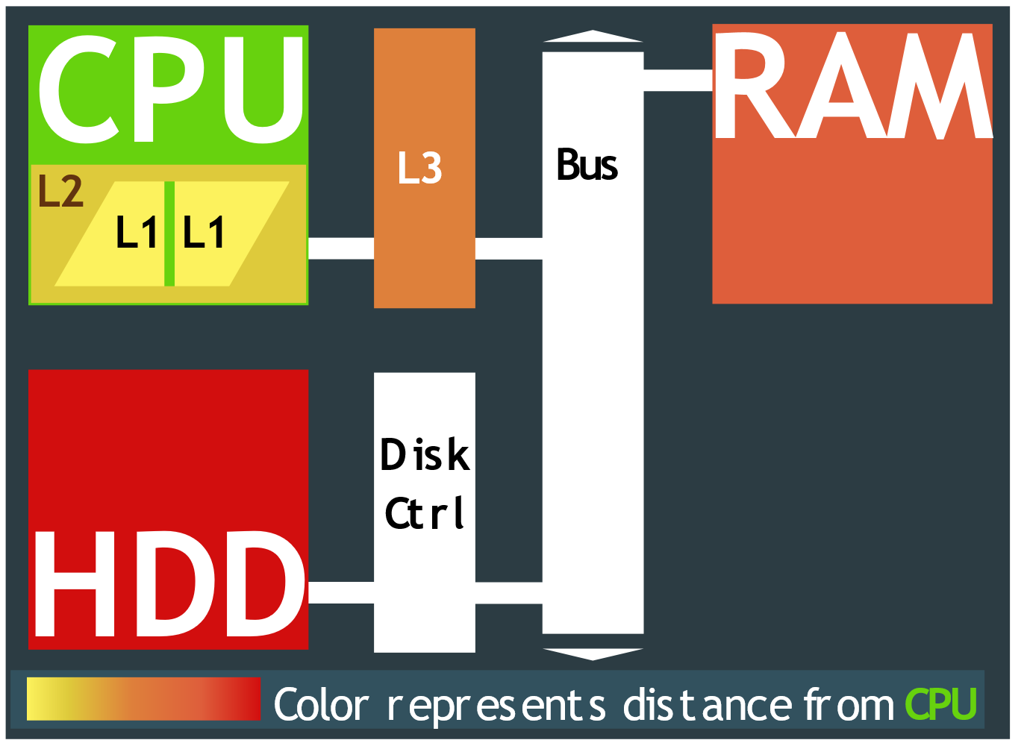
CPU Cache
A typical memory setup
Cache and memory in general exist in a hierarchy
Levels of cache are labelled L1, L2, L3, etc.
L1 cache is also called last level cache
How cache is distributed depends on the machine:
A cache can exist on, built-in to, or outside a processor
Cache can be one per processor, or one per n cores
Locality: Speed of memory read and writes decreases as distance from CPU increases
Cache is the fastest form of memory
Any memory in Li cache exists in Li+1 cache and RAM
Any changes to memory shared by two L1 caches must propogate to the other to maintain correctness
http://flylib.com/books/en/4.414.1.135/1/

Slide 20
Multiple Runqueues in CFS
Considering cache locality and the size of process state information, it would be disadvantageous for the CFS running on each core to consult runqueues external to that core, this is why multiple runqueues are necessary.
The load on each core’s runqueue must stay balanced.
In order to do so most schedulers, including the CFS, periodically run a load-balancing algorithm.
My first primary source Lozi, Lepers, Funston, Gaud, Quéma and Fedorova detailed four issues with the CFS and load balancer.
Some of these bugs have been present for a decade because they were difficult to detect and required new tools to spot. (verify dates, maybe all?)
Let’s look at the load balancer so that we can get to these bugs!

Slide 21
CFS Load Balancer
Threads are assigned a metric called load to best distribute threads to cores
Defining load is trickier than you might expect, but for the sake of brevity here is how it is defined:
Load metric is a combination* of a thread’s weights and average CPU use divided by the number of threads in the parent process.
We divide so that two processes with the same priority, but a different number of threads, still receive a fair amount of time
We factor in the average CPU use so that if you have a program with high priority that isn’t busy, then it shouldn’t need to be scheduled until it is busy
* Lozi et al. did not mention what kind of “combination”

Slide 22
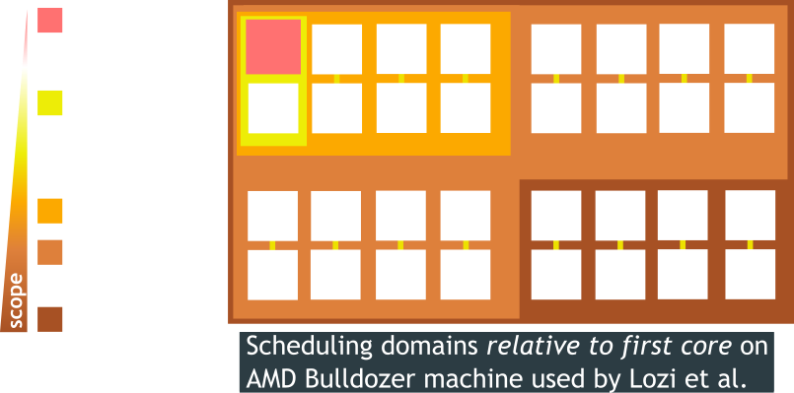
CFS Load Balancer
For efficient balancing, new threads in a process are first considered to be placed on the first core, then nearby cores
This is accomplished using scheduling domains
Scheduling domains differ between cores and exist in a hierarchy based on how they share resources.

Slide 23
CFS Load Balancer
Much like in picking the load metric, the approach to load balancing is also trickier than you might expect.
Load balancing algorithm:
The first core that is idle, else the first core, in any given scheduling domain is responsible for load balancing that domain.
Average load is computed for each scheduling group within each domain where scheduling groups are lower units of scheduling domain
If the busiest group is less busy than the group containing this core, then the threads are considered balanced at this level. (Threads only steal load)
If busiest group is busier, then this core balances load* between these groups.
Many optimizations were made to this algorithm that introduced bugs.
And we are finally prepared to talk about them!
* Lozi et al. did not clarify how scheduling groups balance load

Slide 24
Outline
Establish needed concepts
Thread scheduling and thread load-balancing on Linux
Bug fixes and two new developments to the Linux thread scheduler
Four bugs found within current implementation of CFS
Shuffler: Cache locality improvements via thread migration
FLSCHED: The lockless thread scheduler

Slide 25
Bugs everywhere!
Four bugs:
The Group Imbalance bug
The Scheduling Group Construction bug
The Overload-on-Wakeup bug
The Missing Scheduling Domains bug
Performance results were gathered by running the NAS Parallel Benchmark (NPB) developed by NASA

Slide 26
The Group Imbalance bug
Lozi et al. ran program A with 64 threads at the same time as a single-threaded program B
The load balancer was not balancing A’s threads to idle cores
Because of the division of number of threads in definition of load metric, each of the threads in A had 1/64th the load of B’s thread
But the group containing the 64 A threads and group containing B still had the same load so the load balancer considered the groups balanced!
They fixed the bug by defining the load of a scheduling group as the minimum load amongst cores in the group instead of average
After the fix, program A improved by 13%, program B’s runtime was not affected
A certain program in the NAS Parallel Benchmark improved 13 times
* Program A was make, program B was R

Slide 27
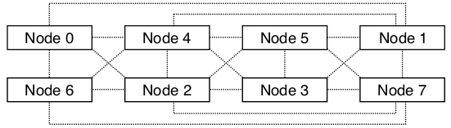
The Scheduling Group Construction bug
The first scheduling group is constructed by adjacent nodes to the first node, then subsequent groups by adjacent nodes of not in any previous group.
It is possible for a node to be within one hop of each starting node
Scheduling groups for the below figure would be [0,1,2,4,6] and [1,2,3,4,5,7]
1 and 2 are in both scheduling domains and are two hops apart
If Node 2 should ever steal work from Node 1, it won’t because 1 and 2 always contribute to the load sum of each scheduling group and be considered balanced.
They fixed this bug by defining scheduling groups to always consider adjacent nodes from the source node, rather than predefined groups.
From Lozi et al.

Slide 28
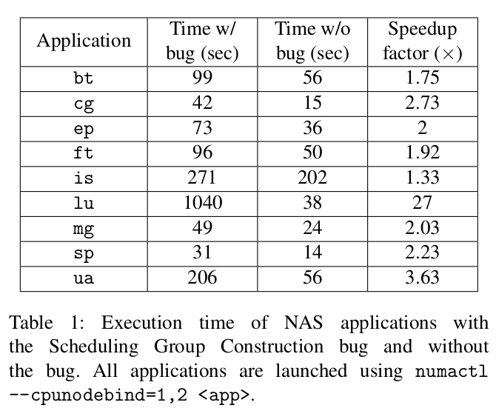
Scheduling Group Construction bugfix Impact
From Lozi et al.

Slide 29
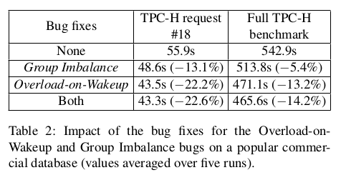
The Overload-on-Wakeup bug
There is an optimization where threads awakened by other threads are placed on the same core to increase cache locality
But it does this disregarding whether it should start on an idle core instead!
This problem only occurs in environments where threads sleep frequently, such as database systems
The fix for this was to modify the wakeup code:
When a thread awakens, if the same core isn’t busy, then it will go there. Otherwise it goes to an idle core
Results on the right are from the commercial database benchmark TPC-H
From Lozi et al.

Slide 30
The Missing Scheduling Domains bug
This bug was fixed, but regressed after a refactor on Linux kernel version 3.19+
Only occurs rarely, when a core is disabled and re-enabled
Bug causes the system to misrepresent amount of scheduling domains and load balancing would never happen
Threads and processes would be stuck on the nodes they’re on
Reintroducing the removed line fixed the problem. Easy peasy.

Slide 31
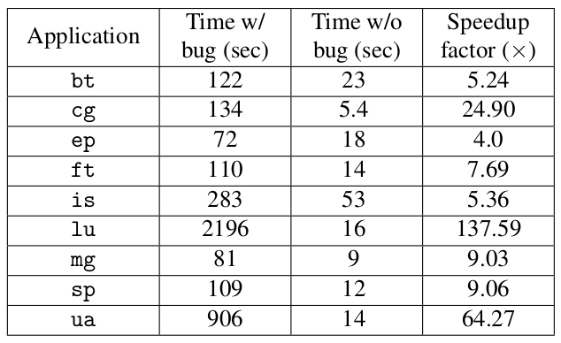
Missing Scheduling Domains bugfix Impact
NAS Parallel Benchmark after disabling and re-enabling one core with and without this bug fix
From Lozi et al.

Slide 32
That’s it for the bugs and bug fixes, now let’s move on to two new scheduling algorithms. Both of them aim to solve a problem experienced primarily by parallel programs on the CFS.
This problem is called Lock contention.

Slide 33
Lock Contention

Slide 34
Shuffler

Slide 35
FLSCHED

Slide 36
Conclusions

Slide 37
References
K. Kumar, P. Rajiv, G. Laxmi, and N. Bhuyan. Shuffling: A framework for lock contention aware thread scheduling for multicore multiprocessor systems. In 2014 23rd International Conference on Parallel Architecture and Compilation Techniques (PACT), pages 289–300, Aug 2014.
J.-P. Lozi, B. Lepers, J. Funston, F. Gaud, V. Quéma, and A. Fedorova. The linux scheduler: A decade of wasted cores. In Proceedings of the Eleventh European Conference on Computer Systems, EuroSys ’16, pages 1:1–1:16, New York, NY, USA, 2016. ACM.
U. B. Nisar, M. Aleem, M. A. Iqbal, and N. S. Vo. Jumbler: A lock-contention aware thread scheduler for multi-core parallel machines. In 2017 International Conference on Recent Advances in Signal Processing, Telecommunications Computing (SigTelCom), pages 77–81, Jan 2017.

